Slide 1

EXTERNAL REVIEW
TITLE:-
Commodity Price Forecasting Model using Machine Learning Techniques
Batch no : 16NCCSS07-23
I.SAI RAM | 160030489
N.SATYA TEJA | 160030987
G. VENKATESH | 160031665
Under the Guidance of
DR.RUDRA KALYAN NAYAK(ASSOC.PROF)

Slide 2
TOPIC OUTLINE
Introduction
Literature Survey
Motivation
Challenges
Objective
Methodology
Proposed Model
Conclusion
References

Slide 3
Introduction
Gold is that the fundamental physical article inside the financial and money related showcase. State and china unit the key shippers among the world and devours unit of time of the overall gold.
Consistently, the cost of the gold can be incremented and can't be controlled.
These days, individuals will in general require a decent footing in gold in light of gigantic benefits in future. The gold costs unit firmly associated with various wares.
A climb in oil costs will have positive effect on gold costs and in this way the elective way around. once there's a climb in values, gold costs goes down.
This might be as an aftereffects of once there's a blast inside the stock trade, the financial specialists will in general require a solid footing the gold cash inside the values.
Henceforth, partner right gold value anticipating is required to predict the business slants in future.

Slide 4
Literature Survey
Title of the Paper | Authors | Techniques | Findings
An improved shuffled frog leaping algorithm based evolutionary rate | Rajashree Dasw (2017) | Evolutionary learning technique Struch as shiffled forpleaping practicle swarm | An evolution forme work using impolled shuffle fropleaping with CEFLANN
forecasting financial time series volatility usingpracticle swarm optimization | Dadabada pradeep kumar Vadla maniravi (2017) | PSO,PSOQRNN,GARCH,MLP,GRNN,GBDH,RE | PSOQRNN can be used as variable alternative in forecasting volaticity
Forecasting of currency exchange rate using an adaptiue ARMA model with difference evoluton based training | Minakhirout,babitamaihi,Ritanjali majhi Ganapati panda (2014) | ARMA,DE,CSO,BFO,FBLMS | ARMA-FBLMS exhibits Worst predicton exchange rate ARMA of exchange rate prediction

Slide 5
Motivation
Trying to predict the gold market is a tasty prospect to information scientists actuated not such a lot as a want for material gain, except for the challenge. We see the daily up and downs of the market and picture there should be patterns we have a tendency to, or our models, will learn so as to beat all those day traders with business degrees. Naturally, after I started victimization additive models for statistic prediction, I had to check the tactic within the workplace of the exchange with simulated funds. Inevitably, I joined the numerous others World Health Organization have tried to beat the market on a daily basis and unsuccessful. However, within the method, I learned a lot of Python together with object-oriented programming, information manipulation, modeling, and image. I additionally distinguished why we should always avoid taking part in the daily exchange while not losing one rupee

Slide 6
Challenges
Demand for gold in Asian nation is interlinking with culture, tradition, need the will the need for beauty and therefore the desire for money protection in keeping with a study by World Gold Council commissioned by the planet Gold Council and Federation of Indian Chambers of Commerce and business (FICCI), Indian shoppers read gold as each associate investment associated an adornment. once asked why they bought gold, nearly seventy seven per cent of respondents cited safety of investment as an element
According to some trade consultants, beneath traditional circumstances, there's a negative relationship between gold and interest rates. Rising yield indicates AN expectation of robust economy. Strong economy offers rise to inflation and gold is employed as a hedge against inflation. Also, once rates rise, investors flock to invariable investments that yield a set come back in contrast to gold that doesn't carry any such come back. So, demand takes a back seat with costs remaining flat.

Slide 7
Objectives
To predict the trend of the gold goods can take away the uncertainty within the future for the investors.
Prediction techniques employed: Multi Variable regression toward the mean model, statistic models, Rough set and Affinity propagation
Rough set and Affinity propagation operate is broken-backed with a singular resolution and vital issue for future analysis
We had studied many other methods like linear regression and logistics for plots

Slide 8
Methodology
ROUGH SET THEORY | AFFINITY PROPAGATION
The accompanying segment contains an outline of the fundamental structure of harsh set hypothesis, as initially proposed by Zdzisław I. Pawlak, alongside a portion of the key definitions. Increasingly formal properties and limits of harsh sets can be found in Pawlak (1991) and refered to references. | The diagonal of s(i,i) is particularly important, as it represents the input preference, meaning how likely a particular input is to become an exemplar. a(i,k)←min(0,r(k,k)+∑i′∉{i,k}max(0,r(i′,k)))a(i,k)←min(0,r(k,k)+∑i′∉{i,k}max(0,r(i′,k))) for i≠k{\displaystyle i\neq
The underlying and essential hypothesis of harsh sets is here and there alluded to as "Pawlak Rough Sets" or "old style unpleasant sets", as a way to recognize from later augmentations and speculations | In insights and information handling, proclivity spread (AP) could be a bunch algorithmic program upheld the build of "message going" between information focuses. dislike bunch calculations like k-means or k-medoids, liking engendering needn't bother with the measure of groups to be resolved
R_*(X) = {xϵU : μ_X^R(x) = 1} - (1) R^*(X) = {xϵU : μ_X^R(x) > 0} - (2) RN_R(X) = {xϵU : 0 <μ_X^R(x) < 1} - (3) | The exemplars are extracted from the final matrices as those whose 'responsibility + availability' for themselves is positive (r(i,i)+a(i,i))>0)

Slide 9
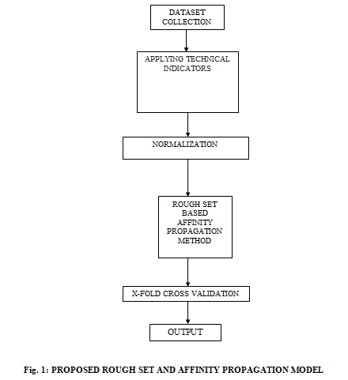
Proposed Model

Slide 10
Experimental Steps
Collection of data set
Data for this study is collected from 1970 to 2019 numerous sources. Knowledge of several government central banks and 5 massive corporations that have endowed vast amounts in gold have conjointly been collected. value of precious metals throughout this amount is additionally enclosed within the analysis. The net sources from that this knowledge was extracted. the value of gold that we tend to are attempting to predict is taken Indian rupee.
Applying Time series indicators
Simple Moving Average(SMA): A simple moving average is the simplest technique of forecasting
Croston: This method is modification of the exponential smoothing. It is a forecast strategy for products with intermittent demand
Neural Network: This method is used to detect the pattern and trend in the data which cannot detect easily for human eye or computer techniques
Autoregressive Integrated Moving Average (ARIMA): It is an statistical technique used to predict the future value of time series data

Slide 11
Experimental steps
Normalization
Minmax normalization is a normalization strategy which linearly transforms x to y= (x-min)/(max-min), where min and max are the minimum and maximum values in X, where X is the set of observed values of x. When x=max, then y=1.
Perform can be measured in
MAPE:The mean absolute percentage error (MAPE), also known as mean absolute percentage deviation (MAPD), is a measure of prediction accuracy of a forecasting method in statistics, for example in trend estimation, also used as a loss function for regression problems in machine learning. It usually expresses accuracy as a percentage, and is defined by the formula:
M=100%/nΣAᵗ-Fᵗ/Aᵗ,
where A_{t} is the actual value and F_{t} is the forecast value. The difference between A_{t} and F_{t} is divided by the actual value A_{t} again. The absolute value in this calculation is summed for every forecasted point in time and divided by the number of fitted points n. Multiplying by 100% makes it a percentage error.
RMSE:Root Mean Square Error (RMSE) is the standard deviation of the residuals (prediction errors). Residuals are a measure of how far from the regression line data points
RMSE=√Σᵑ(yi-yi)2/n

Slide 12
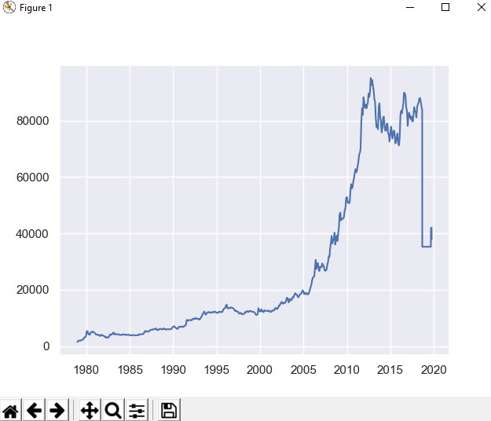
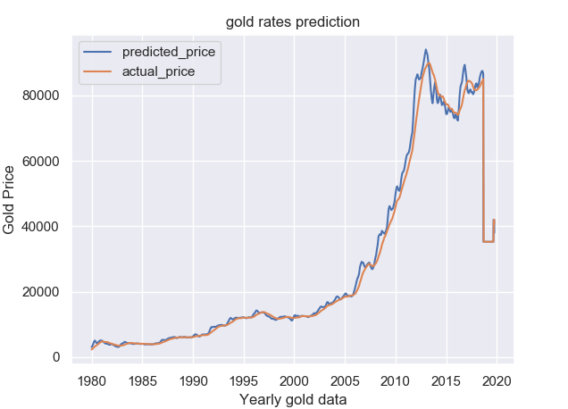
Graphs
Actual graph
Fig1: Actual graph of Roudgset data using yearly data
Fig2:Actual graphs vs Predicted graphs of rough set data using yearly data set

Slide 13
Conclusion
In correct gold worth prediction is critical for predicting the long run gold worth. Therefore during this paper, a brand new learning algorithmic rule referred to as projected algorithmic rule learning is applied that has sensible mental capacity and generalization capability. Due to complex, nonlinear and chaotic behaviour of crude oil dataset, its forecasting becomes complicated. In this case, the proposed Rough-Affinity Propagation model performs well in terms of prediction accuracy and complexity. Literatures indicate that, to construct a generic model for prediction of financial return has been a difficult task. The Rough-Affinity Propagation model is employed over40 years gold dataset. The forecasting accuracy is measured as 89.60% . Further accuracy can be enhanced applying some of the optimization methods.

Slide 14
References
Gary Grudnitski, Larry Osburn, Forecasting S &P and Gold Futures Prices: An Application of Neural Networks, The Journal of Futures Markets, 13(6) : 631-643, 1993.
A.G. Malliaris and Mary Malliaris, Time Series and Neural Networks Comparison on Gold, Oil and the Euro, Proceedings of International Joint Conference on Neural Networks, Atlanta, Georgia, USA, June 14-19, 2009.
MehdiBijari, Gholam AliRaissi Ardali, Improvement of Auto-Regressive Integrated Moving Average models using Fuzzy logic and Artificial Neural Networks (ANNs), Neurocomputing, 72 : 956-967, 2009

